Slide 1
ARIMA models-1 Forecasting
Lecture 4

Slide 2
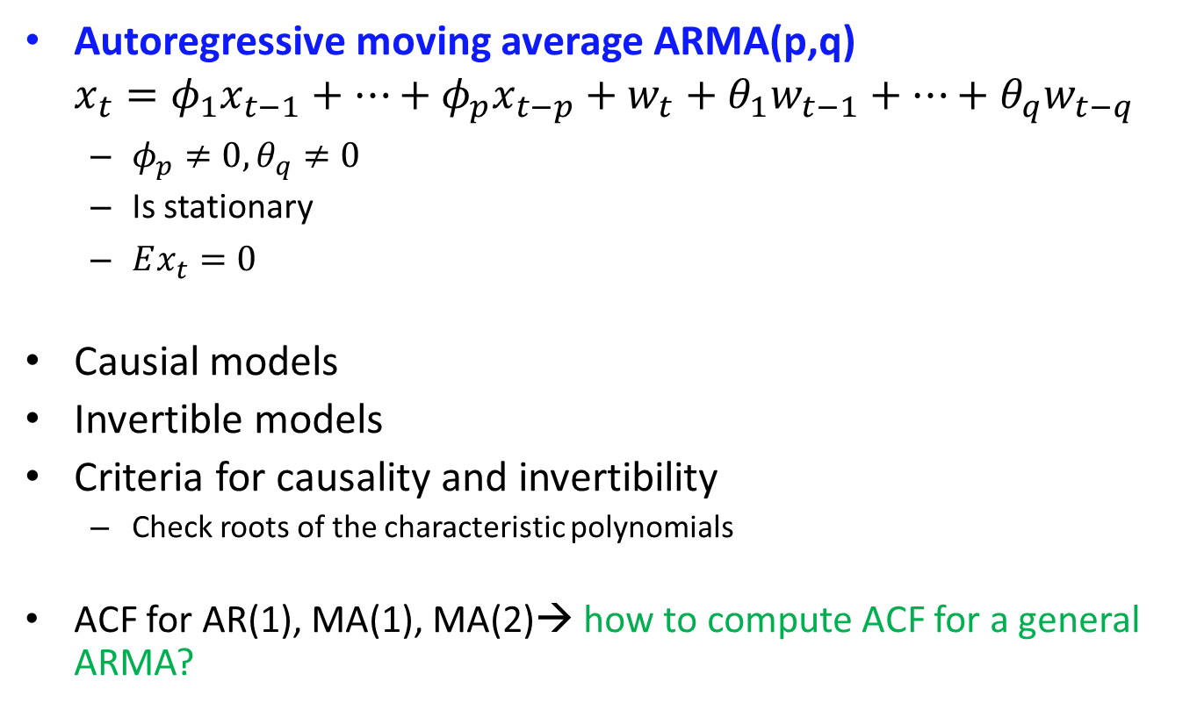
Recap
Autoregressive moving average ARMA(p,q)
$$x_{t}=φ_{1}x_{t−1}+…+φ_{p}x_{t−p}+w_{t}+θ_{1}w_{t−1}+…+θ_{q}w_{t−q}$$
$φ_{p}≠0, θ_{q}≠0$
Is stationary
$Ex_{t}=0$
Causial models
Invertible models
Criteria for causality and invertibility
Check roots of the characteristic polynomials
ACF for AR(1), MA(1), MA(2)→ how to compute ACF for a general ARMA?

Slide 3
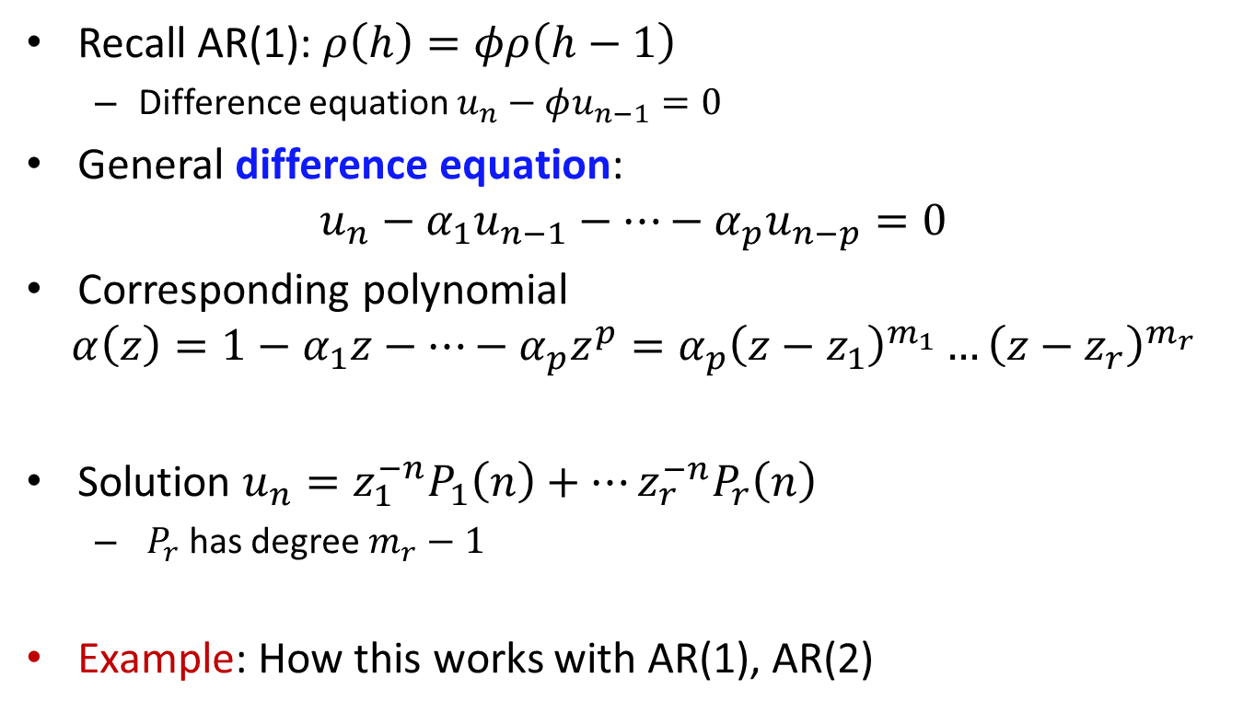
Difference equations
Recall AR(1): $ρ\left(h\right)=φρ\left(h−1\right)$
Difference equation $u_{n}−φu_{n−1}=0$
General difference equation:
$$u_{n}−α_{1}u_{n−1}−…−α_{p}u_{n−p}=0$$
Corresponding polynomial
$$α\left(z\right)=1−α_{1}z−…−α_{p}z^{p}=α_{p}{\left(z−z_{1}\right)}^{m_{1}}…{\left(z−z_{r}\right)}^{m_{r}}$$
Solution $u_{n}=z_{1}^{−n}P_{1}\left(n\right)+…z_{r}^{−n}P_{r}\left(n\right)$
$P_{r}$ has degree $m_{r}−1$
Example: How this works with AR(1), AR(2)

Slide 4
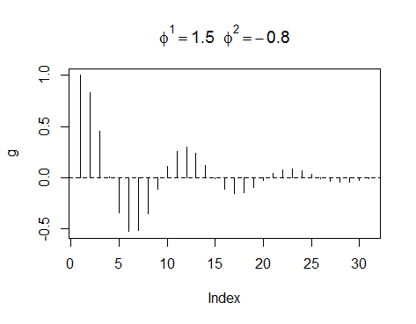
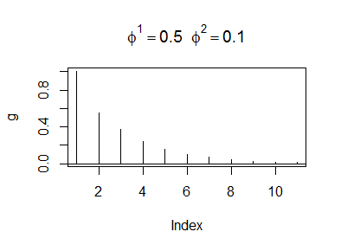
ACF for AR(2)

Slide 5
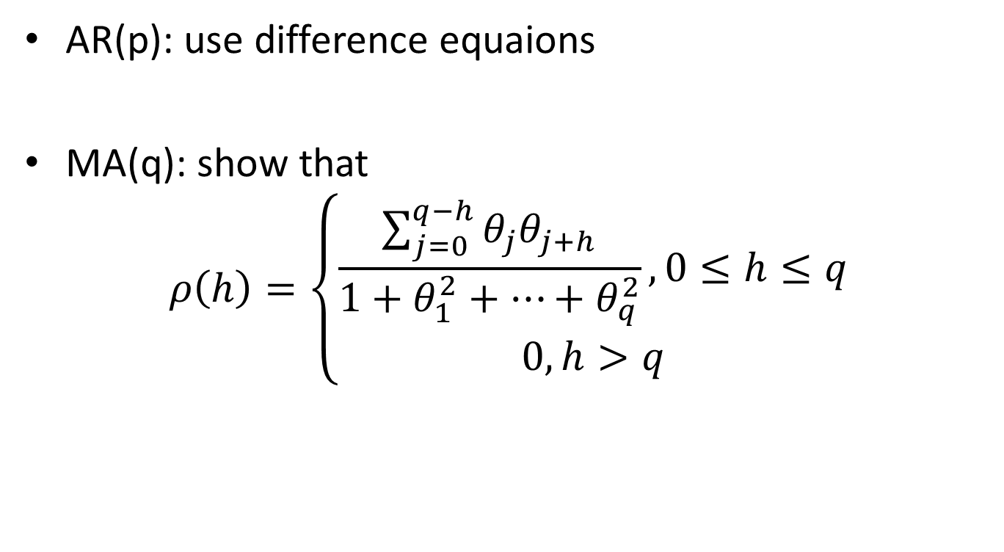
ACF for AR(p), MA(p)
AR(p): use difference equaions
MA(q): show that
$$ρ\left(h\right)=\left\{\begin{aligned}\frac{\sum_{j=0}^{q−h}{θ_{j}θ_{j+h}}}{1+θ_{1}^{2}+…+θ_{q}^{2}}, 0≤h≤q \\ 0, h>q\end{aligned}\right.$$

Slide 6
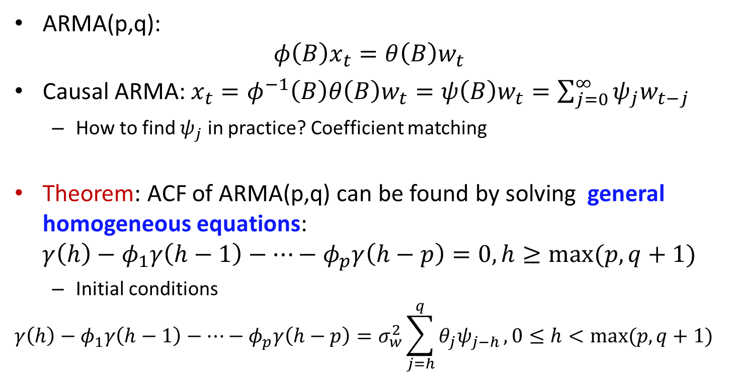
ACF for ARMA(p,q)
ARMA(p,q):
$$φ\left(B\right)x_{t}=θ\left(B\right)w_{t}$$
Causal ARMA: $x_{t}=φ^{−1}\left(B\right)θ\left(B\right)w_{t}=ψ\left(B\right)w_{t}=\sum_{j=0}^{∞}{ψ_{j}w_{t−j}}$
How to find $ψ_{j}$ in practice? Coefficient matching
Theorem: ACF of ARMA(p,q) can be found by solving general homogeneous equations:
$$γ\left(h\right)−φ_{1}γ\left(h−1\right)−…−φ_{p}γ\left(h−p\right)=0, h≥max⁡(p,q+1)$$
Initial conditions
$$γ\left(h\right)−φ_{1}γ\left(h−1\right)−…−φ_{p}γ\left(h−p\right)=σ_{w}^{2}\sum_{j=h}^{q}{θ_{j}ψ_{j−h}}, 0≤h<max⁡(p,q+1)$$

Slide 7
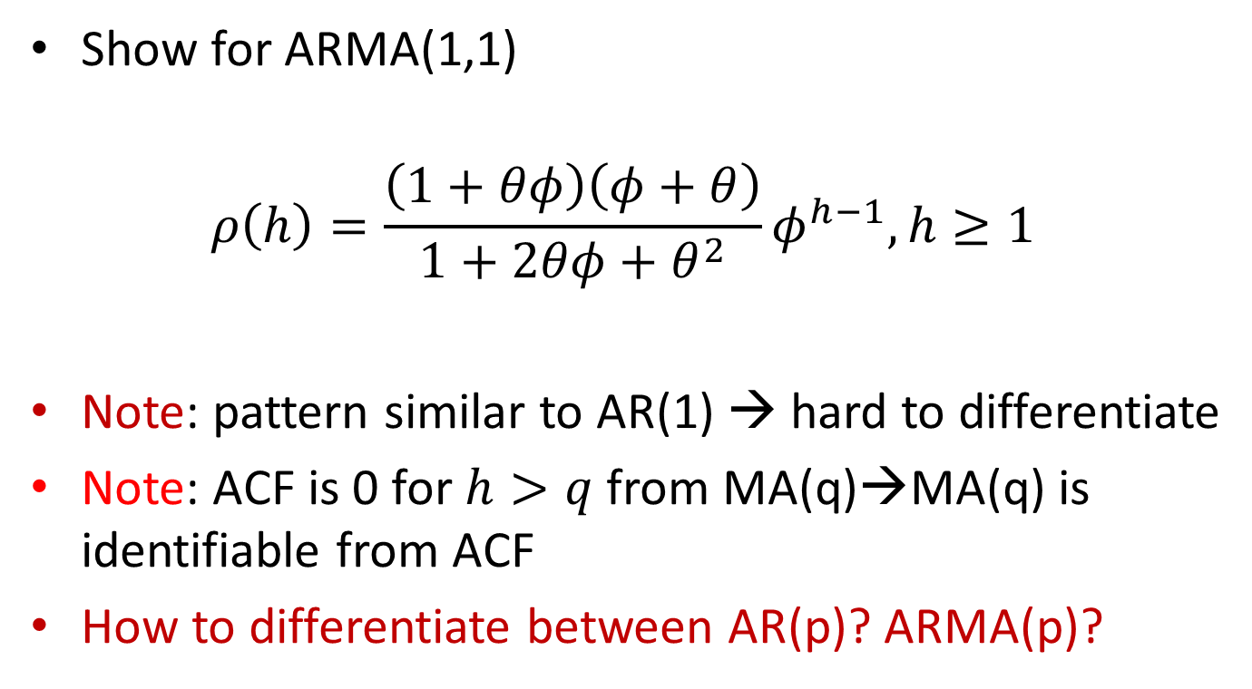
ACF for ARMA(1,1)
Show for ARMA(1,1)
$$ρ\left(h\right)=\frac{\left(1+θφ\right)\left(φ+θ\right)}{1+2θφ+θ^{2}}φ^{h−1}, h≥1$$
Note: pattern similar to AR(1) → hard to differentiate
Note: ACF is 0 for $h>q$ from MA(q)→MA(q) is identifiable from ACF
How to differentiate between AR(p)? ARMA(p)?

Slide 8
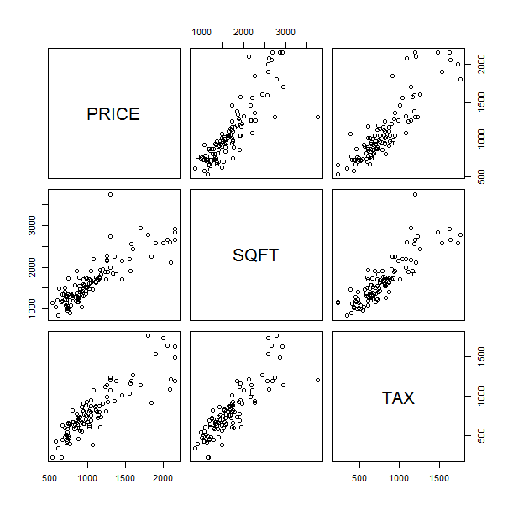
Partial autocorrelation
Example: Albuquerque home prices
What if we remove information stored in TAX from PRICE and SQFT?

Slide 9
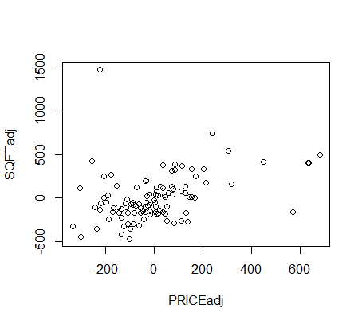

Partial autocorrelation
$\hat{y}={\hat{α}}_{0}+{\hat{α}}_{1}z$
$\hat{x}={\hat{β}}_{0}+{\hat{β}}_{1}z$
$x^{′}=x−\hat{x}$
$y^{′}=y−\hat{y}$
Partial autocorrelation
$$ρ_{xy|z}=corr\left(x^{′},y′\right)$$
If we know $α, β$ and $z$, we can reduce connection between $x$ and $y$
> corr(cbind(PRICEadj,SQFTadj)) [1] 0.3675204

Slide 10


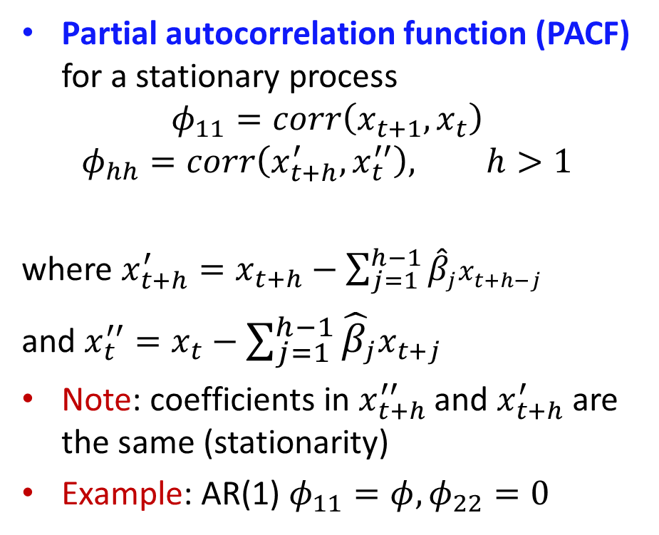



PACF
Partial autocorrelation function (PACF) for a stationary process
$$φ_{11}=corr\left(x_{t+1}, x_{t}\right)$$
$$φ_{hh}=corr\left(x_{t+h}^{′}, x_{t}^{′′}\right), h>1$$
where $x_{t+h}^{′}=x_{t+h}−\sum_{j=1}^{h−1}{{\hat{β}}_{j}x_{t+h−j}}$
and $x_{t}^{′′}=x_{t}−\sum_{j=1}^{h−1}{{\hat{β}}_{j}x_{t+j}}$
Note: coefficients in $x_{t+h}^{′′}$ and $x_{t+h}^{′}$ are the same (stationarity)
Example: AR(1) $φ_{11}=φ, φ_{22}=0$
$$x_{t}$$
$$x_{t+1}$$
$$x_{t+2}$$
$$x_{t+3}$$
$$x_{t+4}$$

Slide 11
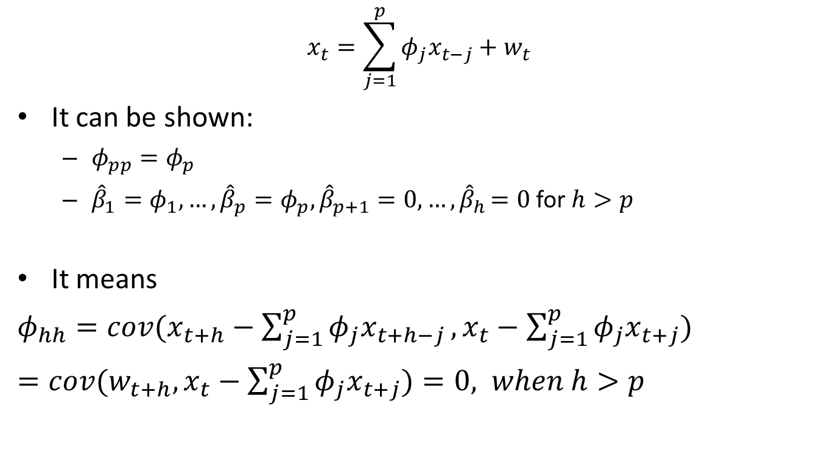
PACF for AR(p)
$$x_{t}=\sum_{j=1}^{p}{φ_{j}x_{t−j}+w_{t}}$$
It can be shown:
$φ_{pp}=φ_{p}$
${\hat{β}}_{1}=φ_{1},…,{\hat{β}}_{p}=φ_{p},{\hat{β}}_{p+1}=0,…{,\hat{β}}_{h}=0$ for $h>p$
It means
$φ_{hh}=cov(x_{t+h}−\sum_{j=1}^{p}{φ_{j}x_{t+h−j}}, x_{t}−$ $\sum_{j=1}^{p}{φ_{j}x_{t+j}})$
$=cov(w_{t+h}, x_{t}−$ $\sum_{j=1}^{p}{φ_{j}x_{t+j}})=0, when h>p$

Slide 12
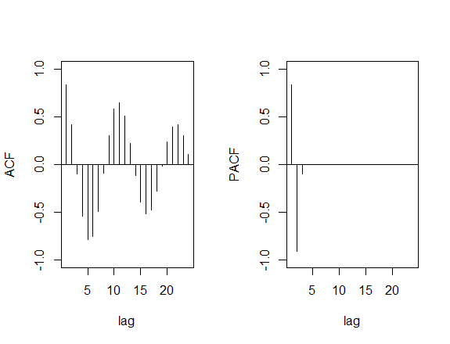

PACF for AR(p)
Example: AR(3) $φ_{1}=1.5,φ_{2}=−0.75, φ_{3}=−0.1$

Slide 13
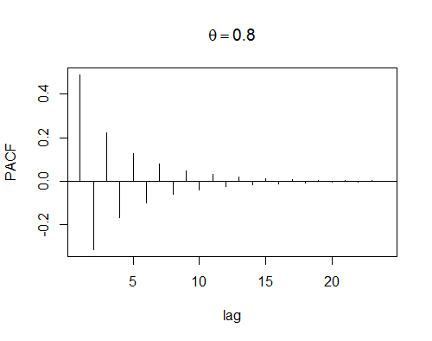

PACF for MA(1)
If invertible,
$$φ_{hh}=−\frac{{\left(−θ\right)}^{h}\left(1−θ^{2}\right)}{1−θ^{2h+2}}, h≥1$$
Decreases exponentially with h

Slide 14
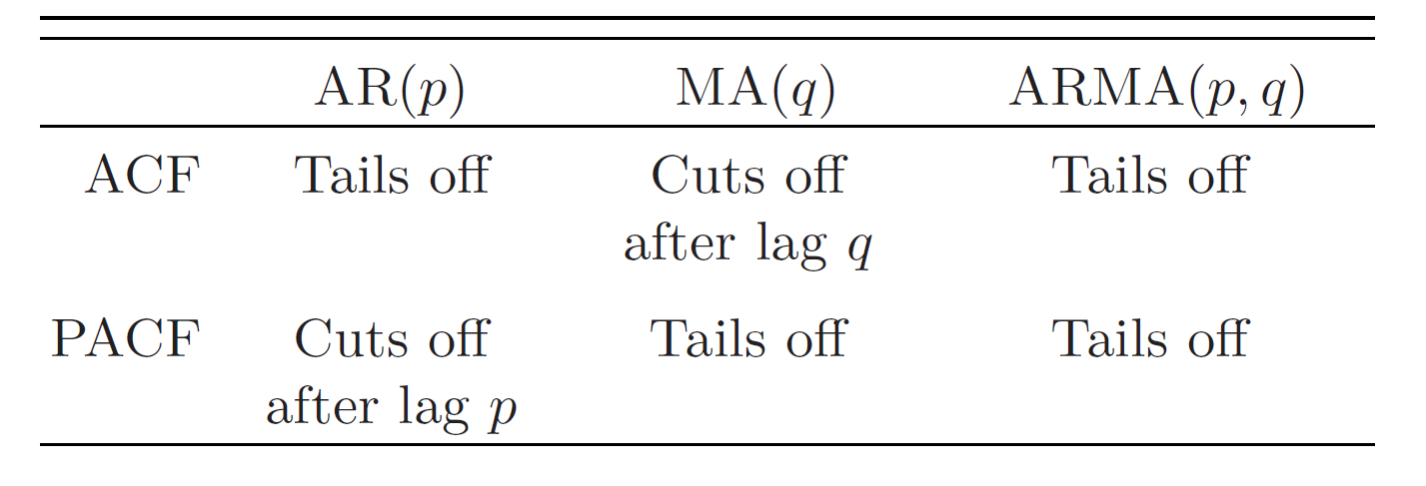
ACF and PACF
How to differentiate between ARMA(p,q)?

Slide 15
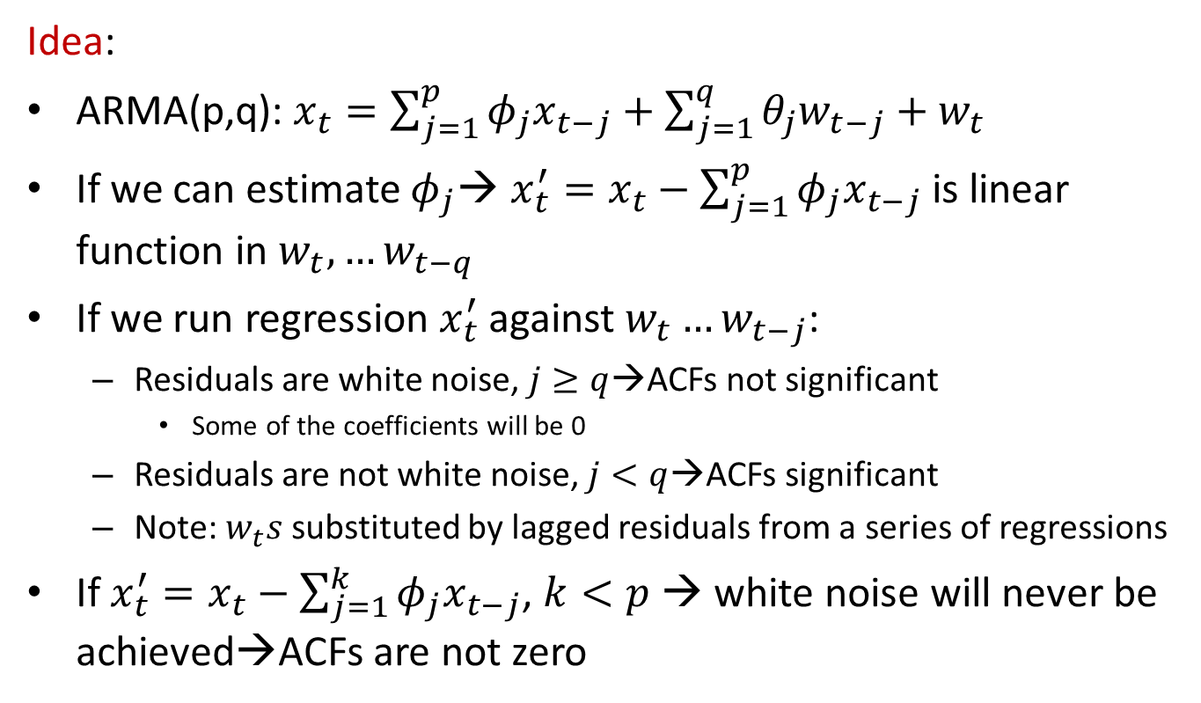
Empirical ACF (EACF)
Idea:
ARMA(p,q): $x_{t}=\sum_{j=1}^{p}{φ_{j}x_{t−j}+\sum_{j=1}^{q}{θ_{j}w_{t−j}}}+w_{t}$
If we can estimate $φ_{j}$→ ${x_{t}^{′}=x}_{t}−\sum_{j=1}^{p}{φ_{j}x_{t−j}}$ is linear function in $w_{t},…w_{t−q}$
If we run regression $x_{t}^{′}$ against $w_{t}…w_{t−j}$:
Residuals are white noise, $j≥q$→ACFs not significant
Some of the coefficients will be 0
Residuals are not white noise, $j<q$→ACFs significant
Note: $w_{t}s$ substituted by lagged residuals from a series of regressions
If ${x_{t}^{′}=x}_{t}−\sum_{j=1}^{k}{φ_{j}x_{t−j}}$, $k<p$ → white noise will never be achieved→ACFs are not zero

Slide 16

Empirical ACF (EACF)
$k>p$? General result: ACFs are 0 for $j>q+\left(k−p\right)$
Example: ARMA(0,1)
General conclusion for $\left(AR,MA\right)=(k,j)$:
This is theoretical one!→ not exactly the same for the samples
AR/MA | 0 | 1 | 2 | … | … | … | …
0 | X | X | X | X | X | X | X
1 | X | X | X | X | X | X | X
2 | X | X | X | X | X | X | X
… | X | X | X | X | X | X | X
… | X | X | X | X | X | X | X
… | X | X | 0 | 0 | 0 | 0 | 0
… | X | X | X | 0 | 0 | 0 | 0
… | X | X | X | X | 0 | 0 | 0
… | X | X | X | X | X | 0 | 0

Slide 17
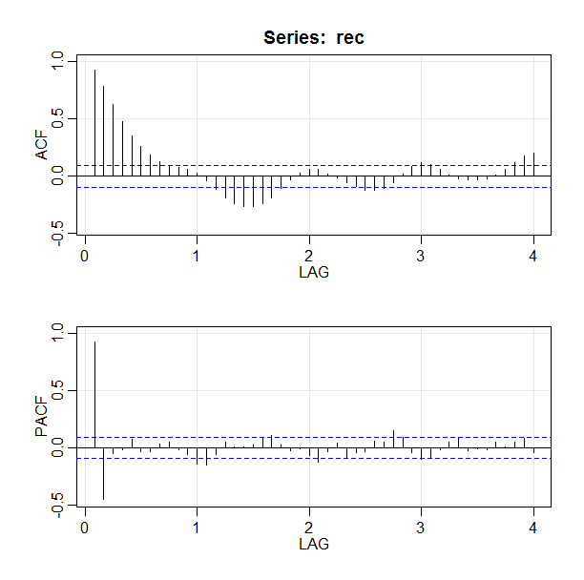
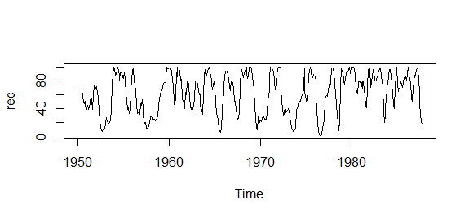
ARMA orders
Recruitment series
Conclusion?

Slide 18
ARMA orders
EACF
> TSA::eacf(rec)
AR/MA
0 1 2 3 4 5 6 7 8 9 10 11 12 13
0 x x x x x x x x o o o o o x
1 x x x o o o o o o o o o o o
2 o o x x o o o o o o o o o o
3 x o o x o o o o o o o o o o
4 x x o o o o o o o o o o o o
5 x x x o o o o o o o o o o o
6 x x x o o o o o o o o o o o
7 x x o o o o o o o o o o x o

Slide 19
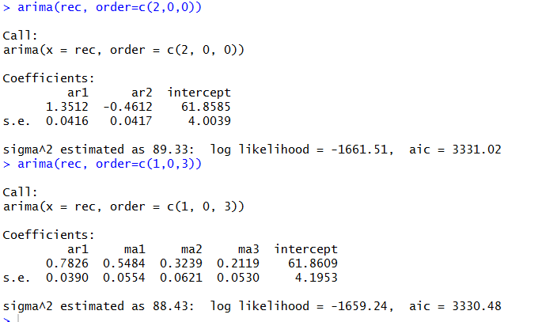
ARMA orders
AR(2) and ARMA(1,3)
Conclusions?

Slide 20
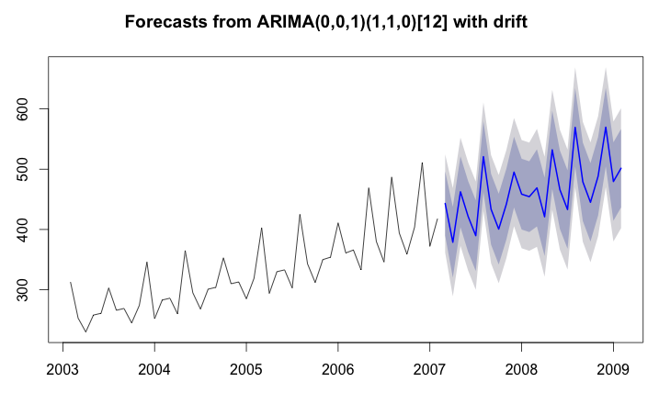

Forecasting
We have our series $x_{1}…x_{n}$
Use series to predict $m$ steps ahead: $x_{n+m}^{n}$ should be based on our observed data $x_{n+m}^{n}=g(x_{1},…x_{n})$

Slide 21
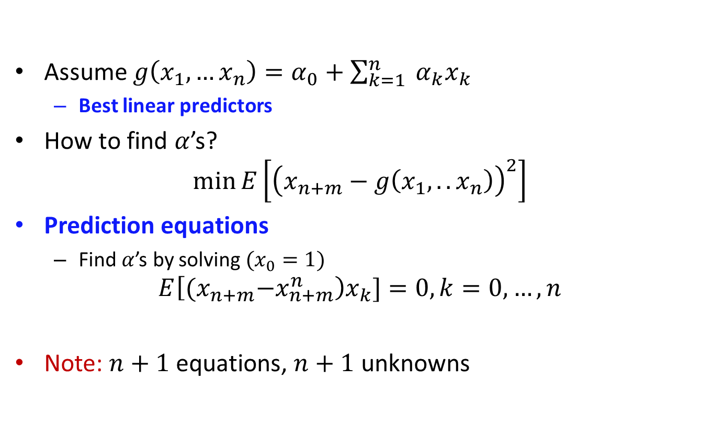
Forecasting
Assume $g\left(x_{1},…x_{n}\right)=α_{0}+\sum_{k=1}^{n}{ α_{k}x_{k}}$
Best linear predictors
How to find $α$’s?
$$\min{E\left[{\left(x_{n+m}−g\left(x_{1},..x_{n}\right)\right)}^{2}\right]}$$
Prediction equations
Find $α$’s by solving $(x_{0}=1)$
$$E\left[{(x}_{n+m}−x_{n+m}^{n}\right)x_{k}]=0, k=0,…,n$$
Note: $n+1$ equations, $n+1$ unknowns

Slide 22
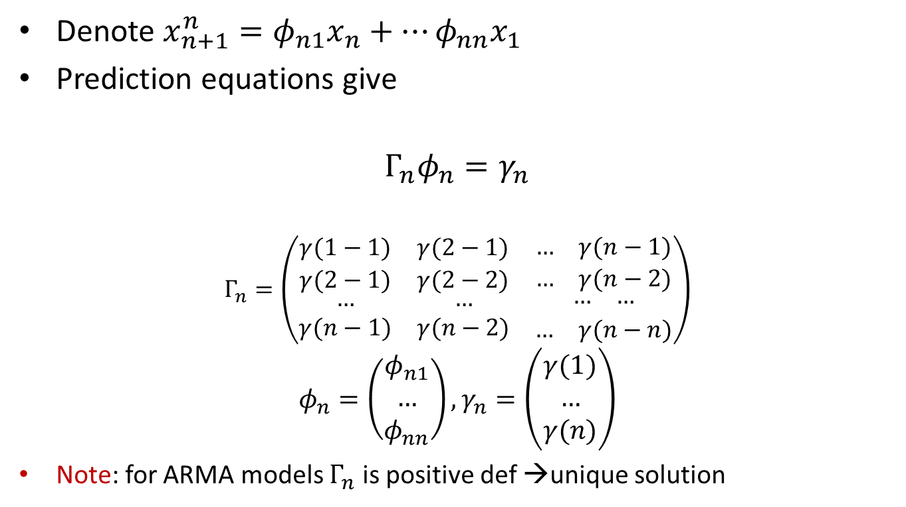
One-step-ahead
Denote $x_{n+1}^{n}=φ_{n1}x_{n}+…φ_{nn}x_{1}$
Prediction equations give
$$Γ_{n}φ_{n}=γ_{n}$$
$$Γ_{n}=\left(\begin{matrix}γ(1−1) & γ(2−1) & \begin{matrix}… & γ(n−1)\end{matrix} \\ γ(2−1) & γ(2−2) & \begin{matrix}… & γ(n−2)\end{matrix} \\ \begin{aligned}… \\ γ(n−1)\end{aligned} & \begin{aligned}… \\ γ(n−2)\end{aligned} & \begin{aligned}\begin{matrix}… & …\end{matrix} \\ \begin{matrix}… & γ(n−n)\end{matrix}\end{aligned}\end{matrix}\right)$$
$$φ_{n}=\left(\begin{matrix}φ_{n1} \\ … \\ φ_{nn}\end{matrix}\right), γ_{n}=\left(\begin{matrix}γ(1) \\ … \\ γ(n)\end{matrix}\right)$$
Note: for ARMA models $Γ_{n}$ is positive def →unique solution

Slide 23
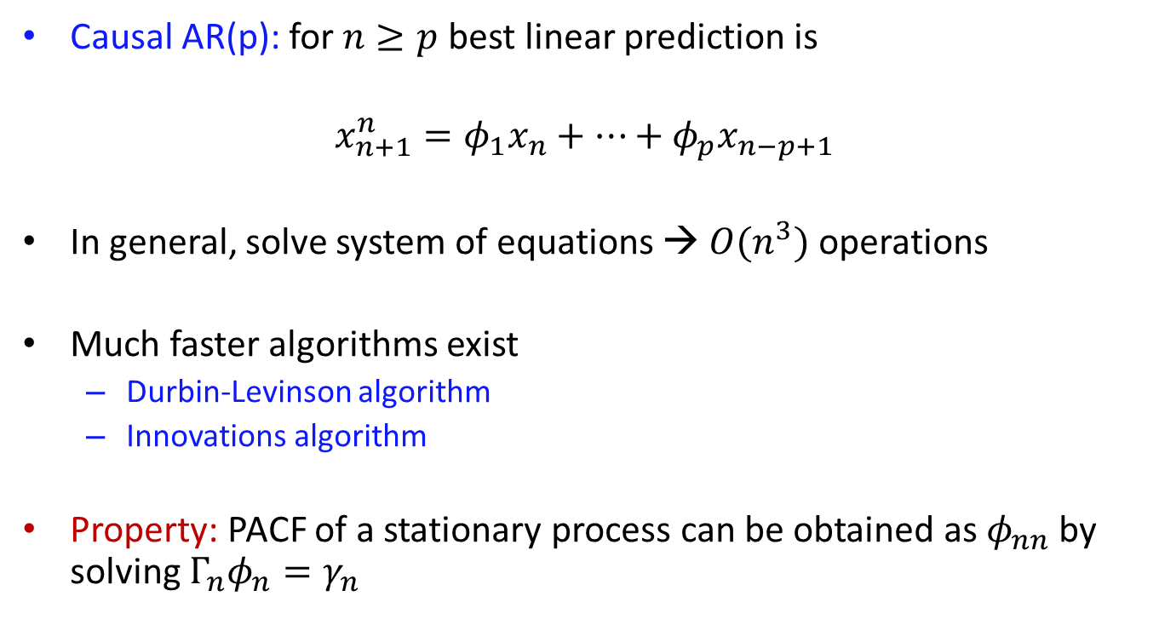
One-step-ahead
Causal AR(p): for $n≥p$ best linear prediction is
$$x_{n+1}^{n}=φ_{1}x_{n}+…+φ_{p}x_{n−p+1}$$
In general, solve system of equations → $O(n^{3})$ operations
Much faster algorithms exist
Durbin-Levinson algorithm
Innovations algorithm
Property: PACF of a stationary process can be obtained as $φ_{nn}$ by solving $Γ_{n}φ_{n}=γ_{n}$

Slide 24
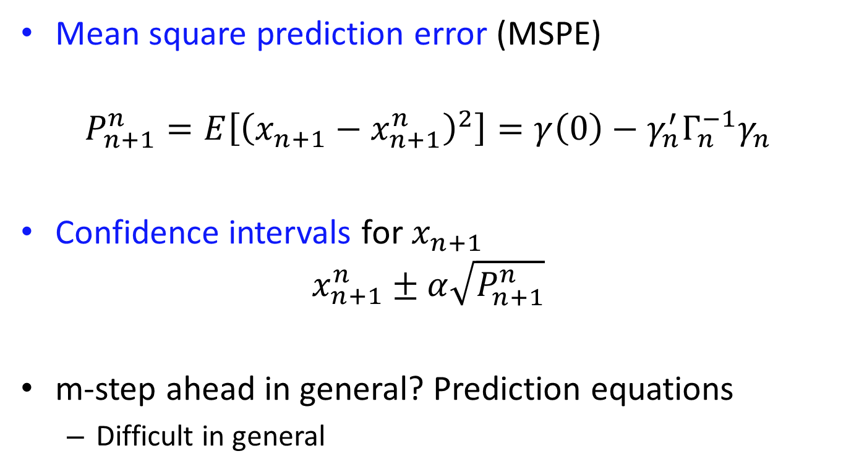
One-step-ahead
Mean square prediction error (MSPE)
$$P_{n+1}^{n}=E\left[{\left(x_{n+1}−x_{n+1}^{n}\right)}^{2}\right]=γ\left(0\right)−γ_{n}^{′}Γ_{n}^{−1}γ_{n}$$
Confidence intervals for $x_{n+1}$
$$x_{n+1}^{n}±α\sqrt{P_{n+1}^{n}}$$
m-step ahead in general? Prediction equations
Difficult in general

Slide 25
Read home
Ch 3.2-3.4
Paper ” Consistent Estimates of Autoregressive Parameters and Extended Sample Autocorrelation” by Tsay and Tiao
R code: eacf in TSA package

